Slide 1
A HISTORICAL REVIEW OF CONTEMPORARY LOGIC ORIGINS
Created by student of group DA-92
Nasikan Dmytro

Slide 2
THE ORIGINS OF LOGIC
Logic began independently in the eastern (India and China) and western (Greece) parts of the world in the 6th Century BC .
Significant impact into development of logic was made by:
Aristotle
Leibniz
Boole
Pierce
de Morgan
Brentano
Frege

Slide 3
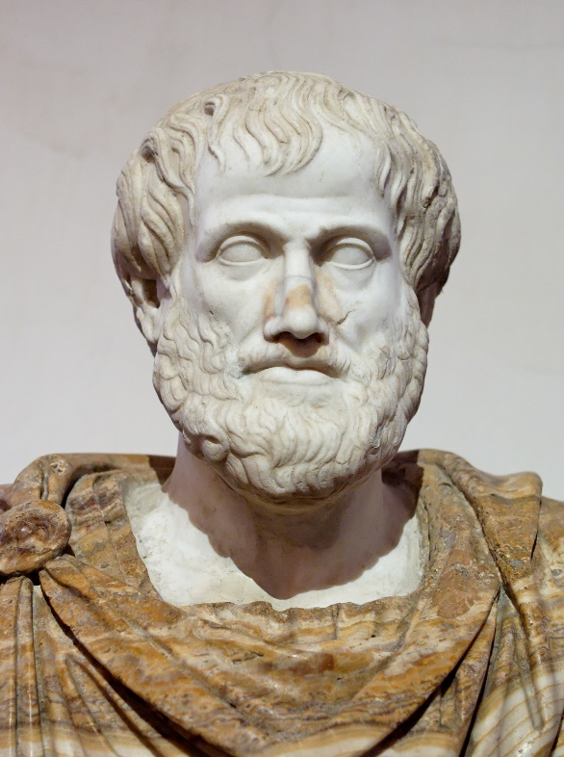
ARISTOTLE
Aristotle was a Greek philosopher and polymath during the Classical period in Ancient Greece. Aristotle is credited with the earliest study of formal logic and his conception of it was the dominant form of Western logic until 19th-century advances in mathematical logic.

Slide 4
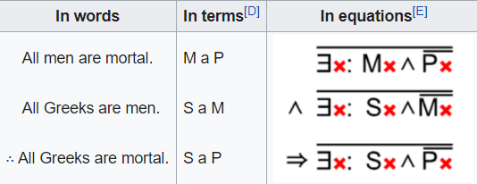
ARISTOTLE
The logical works of Aristotle were compiled into a set of six books called the Organon around 40 BC by Andronicus of Rhodes or others among his followers.
Also, Aristotle is the father of syllogisms:

Slide 5
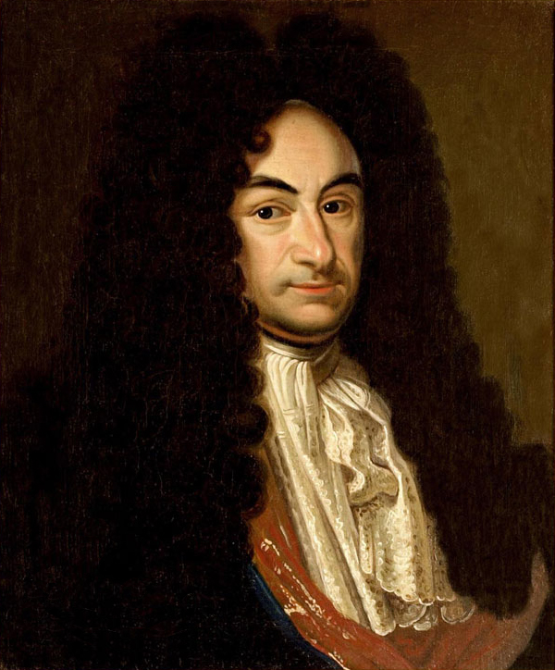
GOTTFRIED WILHELM LEIBNIZ
Gottfried Wilhelm (von) Leibniz was a prominent German polymath and one of the most important logicians, mathematicians and natural philosophers of the Enlightenment.

Slide 6
GOTTFRIED WILHELM LEIBNIZ
Leibniz has been noted as one of the most important logicians between the times of Aristotle and Gottlob Frege. Leibniz enunciated the principal properties of what we now call conjunction, disjunction, negation, identity, set inclusion, and the empty set.
The principles of Leibniz's logic reduce to two:
All our ideas are compounded from a very small number of simple ideas, which form the alphabet of human thought.
Complex ideas proceed from these simple ideas by a uniform and symmetrical combination, analogous to arithmetical multiplication.

Slide 7
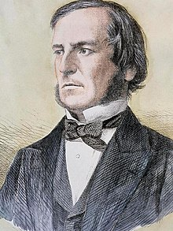
GEORGE BOOLE
George Boole was a largely self-taught English mathematician, philosopher and logician, most of whose short career was spent as the first professor of mathematics at Queen's College, Cork in Ireland.

Slide 8
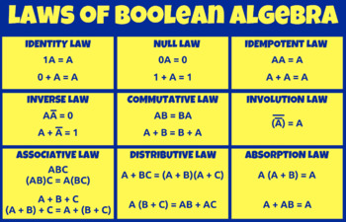
GEORGE BOOLE
George Boole helped establish modern symbolic logic and whose algebra of logic, now called Boolean Algebra is basic to the design of digital computer circuits.

Slide 9
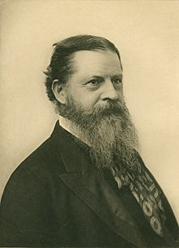
CHARLES SANDERS PEIRCE
Charles Sanders Peirce was an American philosopher, logician, mathematician, and scientist who is sometimes known as "the father of pragmatism".

Slide 10
CHARLES SANDERS PEIRCE
His contributions to the development of modern logic at the turn of the 20th century were colossal, original and influential. Formal, or deductive, logic was just one of the branches in which he exercized his logical and analytical talent. His work developed upon Boole’s algebra of logic and De Morgan’s logic of relations.

Slide 11
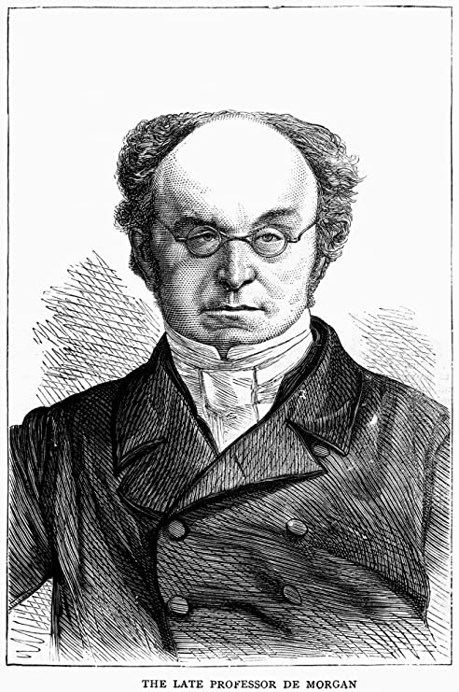
AUGUSTUS DE MORGAN
Augustus De Morgan was a British mathematician and logician. He formulated De Morgan's laws and introduced the term mathematical induction, making its idea rigorous.

Slide 12
AUGUSTUS DE MORGAN
The De Morgan's laws:
The negation of a conjunction is the disjunction of the negations.
The negation of a disjunction is the conjunction of the negations.
¬(A ^ B) ↔ (¬A) v (¬B)
¬(A v B) ↔ (¬A) ^ (¬B)

Slide 13
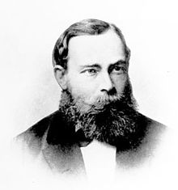
GOTTLOB FREGE
Friedrich Ludwig Gottlob Frege was a German philosopher, logician, and mathematician. His contributions include the development of modern logic and work in the foundations of mathematics.

Slide 14
GOTTLOB FREGE
Considered to be the father of Analytic Philosophy.
His Objective was demonstrating that arithmetic is identical with logic.
He invented axiomatic predicate logic and quantified variables, which solved the problem of multiple generality.

Slide 15
Thank You
Created by student of group DA-92
Nasikan Dmytro

